Slide 1
CCS3104
ADVANCED PROGRAMMING
Chapter 1 Basic GUI Programming

Slide 2
Motivations
JavaFX is a new framework for developing Java GUI programs. The JavaFX API is an excellent example of how the object-oriented principle is applied. This chapter serves two purposes. First, it presents the basics of JavaFX programming. Second, it uses JavaFX to demonstrate OOP. Specifically, this chapter introduces the framework of JavaFX and discusses JavaFX GUI components and their relationships.

Slide 3
Objectives
To distinguish between JavaFX, Swing, and AWT (§14.2).
To write a simple JavaFX program and understand the relationship among stages, scenes, and nodes (§14.3).
To create user interfaces using panes, UI controls, and shapes (§14.4).
To use the common properties style and rotate for nodes (§14.6).
To create colors using the Color class (§14.7).
To create fonts using the Font class (§14.8).
To create images using the Image class and to create image views using the ImageView class (§14.9).
To layout nodes using Pane, StackPane, FlowPane, GridPane, BorderPane, HBox, and VBox (§14.10).

Slide 4
JavaFX vs Swing and AWT
Swing and AWT are replaced by the JavaFX platform for developing rich Internet applications.
When Java was introduced, the GUI classes were bundled in a library known as the Abstract Windows Toolkit (AWT).
AWT is fine for developing simple graphical user interfaces, but not for developing comprehensive GUI projects.
AWT is prone to platform-specific bugs. The AWT user-interface components were replaced by a more robust, versatile, and flexible library known as Swing components.
Swing components are painted directly on canvases using Java code. Swing components depend less on the target platform and use less of the native GUI resource.
With the release of Java 8, Swing is replaced by a completely new GUI platform known as JavaFX.
Notes:
But see also the Wikipedia entry for JavaFX (https://en.wikipedia.org/wiki/JavaFX)

Slide 5
Basic Structure of JavaFX
Application
Override the start(Stage) method
Stage, Scene, and Nodes
MyJavaFX
Run
MultipleStageDemo
Run

Slide 6
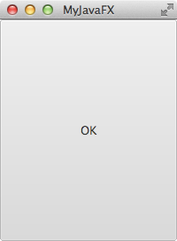
import javafx.application.Application;
import javafx.scene.Scene;
import javafx.scene.control.Button;
import javafx.stage.Stage;
public class MyJavaFX extends Application {
@Override // Override the start method in the Application class
public void start(Stage primaryStage) {
// Create a button and place it in the scene
Button btOK = new Button("OK");
Scene scene = new Scene(btOK, 200, 250);
primaryStage.setTitle("MyJavaFX"); // Set the stage title
primaryStage.setScene(scene); // Place the scene in the stage
primaryStage.show(); // Display the stage
}
/**
* The main method is only needed for the IDE with limited
* JavaFX support. Not needed for running from the command line.
*/
public static void main(String[] args) {
launch(args);
}
}

Slide 7
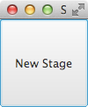
import javafx.application.Application;
import javafx.scene.Scene;
import javafx.scene.control.Button;
import javafx.stage.Stage;
public class MultipleStageDemo extends Application {
@Override // Override the start method in the Application class
public void start(Stage primaryStage) {
// Create a scene and place a button in the scene
Scene scene = new Scene(new Button("OK"), 200, 250);
primaryStage.setTitle("MyJavaFX"); // Set the stage title
primaryStage.setScene(scene); // Place the scene in the stage
primaryStage.show(); // Display the stage
Stage stage = new Stage(); // Create a new stage
stage.setTitle("Second Stage"); // Set the stage title
// Set a scene with a button in the stage
stage.setScene(new Scene(new Button("New Stage"), 100, 100));
stage.show(); // Display the stage
}
/**
* The main method is only needed for the IDE with limited
* JavaFX support. Not needed for running from the command line.
*/
public static void main(String[] args) {
launch(args);
}
}

Slide 8
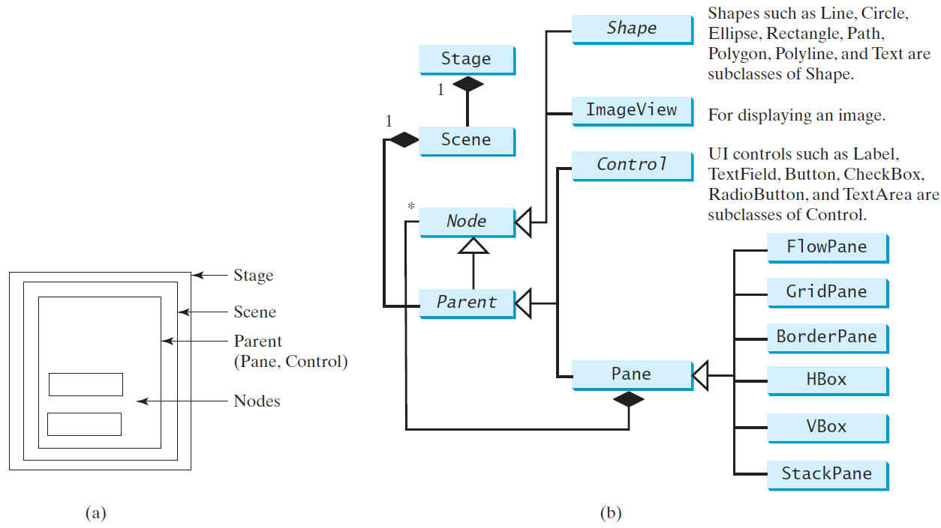
Panes, UI Controls, and Shapes
ButtonInPane
Run

Slide 9

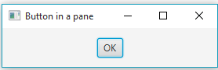
import javafx.application.Application;
import javafx.scene.Scene;
import javafx.scene.control.Button;
import javafx.scene.layout.StackPane;
import javafx.stage.Stage;
public class ButtonInPane extends Application {
@Override // Override the start method in the Application class
public void start(Stage primaryStage) {
// Create a scene and place a button in the scene
StackPane pane = new StackPane();
pane.getChildren().add(new Button("OK"));
Scene scene = new Scene(pane, 200, 50);
primaryStage.setTitle("Button in a pane"); // Set the stage title
primaryStage.setScene(scene); // Place the scene in the stage
primaryStage.show(); // Display the stage
}
/**
* The main method is only needed for the IDE with limited
* JavaFX support. Not needed for running from the command line.
*/
public static void main(String[] args) {
launch(args);
}
}

Slide 10
Common Properties and Methods for Nodes
style: set a JavaFX CSS style
rotate: Rotate a node
NodeStyleRotateDemo
Run

Slide 11
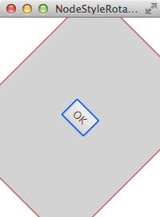
import javafx.application.Application;
import javafx.scene.Scene;
import javafx.scene.control.Button;
import javafx.stage.Stage;
import javafx.scene.layout.StackPane;
public class NodeStyleRotateDemo extends Application {
@Override // Override the start method in the Application class
public void start(Stage primaryStage) {
// Create a scene and place a button in the scene
StackPane pane = new StackPane();
Button btOK = new Button("OK");
btOK.setStyle("-fx-border-color: blue;");
pane.getChildren().add(btOK);
pane.setRotate(45);
pane.setStyle(
"-fx-border-color: red; -fx-background-color: lightgray;");
Scene scene = new Scene(pane, 200, 250);
primaryStage.setTitle("NodeStyleRotateDemo"); // Set the stage title
primaryStage.setScene(scene); // Place the scene in the stage
primaryStage.show(); // Display the stage
}
/**
* The main method is only needed for the IDE with limited
* JavaFX support. Not needed for running from the command line.
*/
public static void main(String[] args) {
launch(args);
}
}

Slide 12
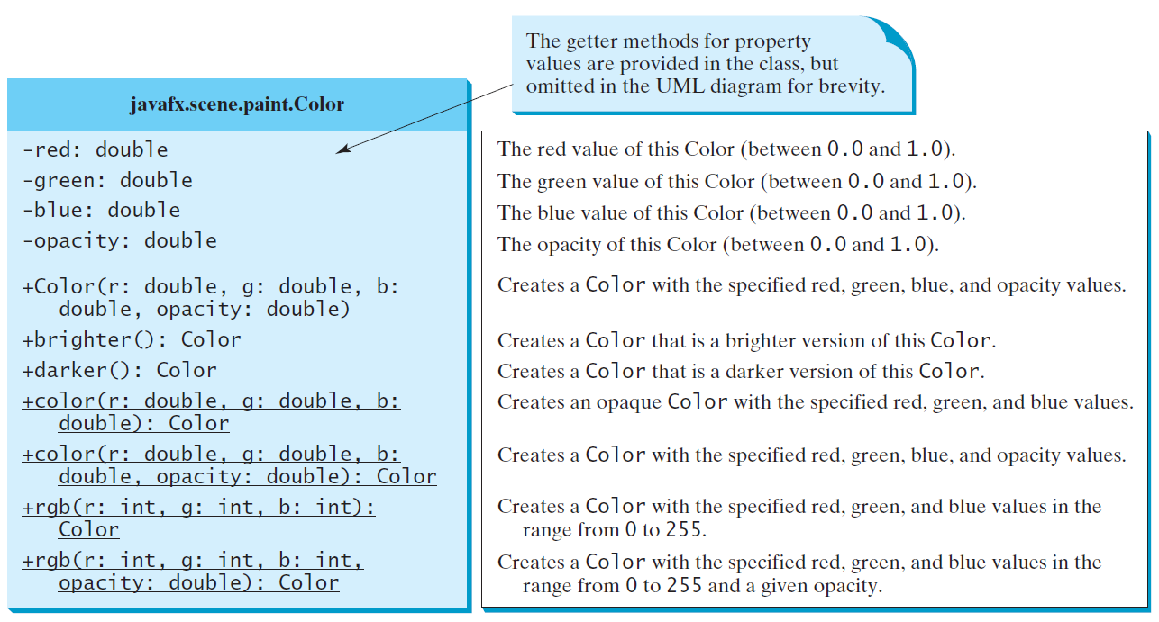
The Color Class

Slide 13
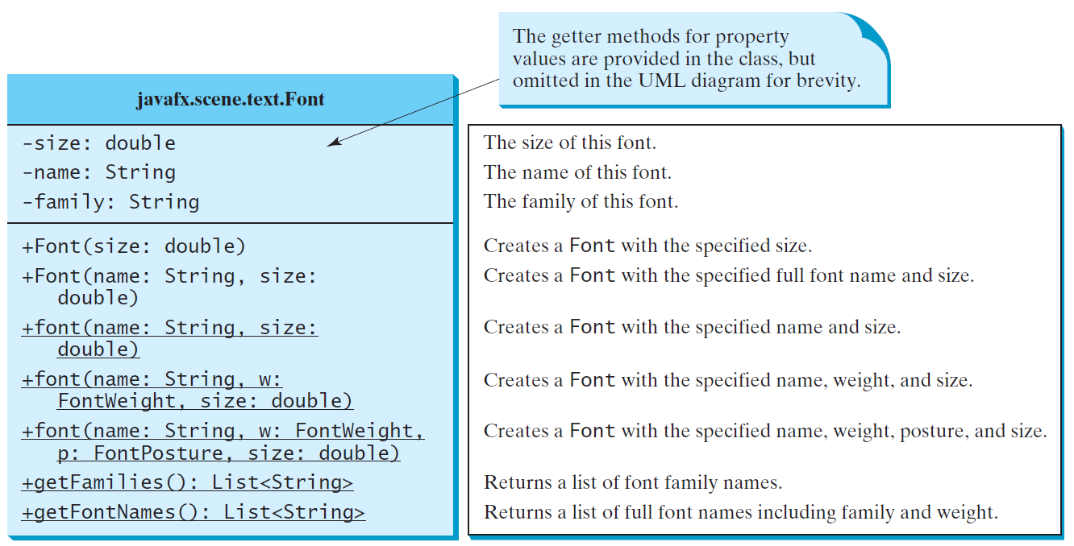
The Font Class
FontDemo
Run

Slide 14
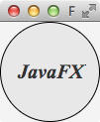
import javafx.application.Application;
import javafx.scene.Scene;
import javafx.scene.layout.*;
import javafx.scene.paint.Color;
import javafx.scene.shape.Circle;
import javafx.scene.text.*;
import javafx.scene.control.*;
import javafx.stage.Stage;
public class FontDemo extends Application {
@Override
// Override the start method in the Application class
public void start(Stage primaryStage) {
// Create a pane to hold the circle
Pane pane = new StackPane();
// Create a circle and set its properties
Circle circle = new Circle();
circle.setRadius(50);
circle.setStroke(Color.BLACK);
circle.setFill(new Color(0.5, 0.5, 0.5, 0.1));
pane.getChildren().add(circle); // Add circle to the pane
// Create a label and set its properties
Label label = new Label("JavaFX");
label.setFont(Font.font("Times New Roman",
FontWeight.BOLD, FontPosture.ITALIC, 20));
pane.getChildren().add(label);
// Create a scene and place it in the stage
Scene scene = new Scene(pane);
primaryStage.setTitle("FontDemo"); // Set the stage title
primaryStage.setScene(scene); // Place the scene in the stage
primaryStage.show(); // Display the stage
}
/**
* The main method is only needed for the IDE with limited
* JavaFX support. Not needed for running from the command line.
*/
public static void main(String[] args) {
launch(args);
}
}

Slide 15
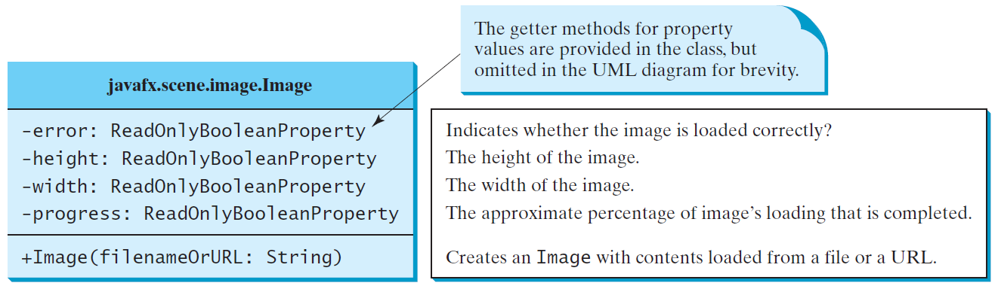
The Image Class
Note: The images for this topic can be obtained from https://liveexample.pearsoncmg.com/common/image/, e.g. https://liveexample.pearsoncmg.com/common/image/us.gif.

Slide 16
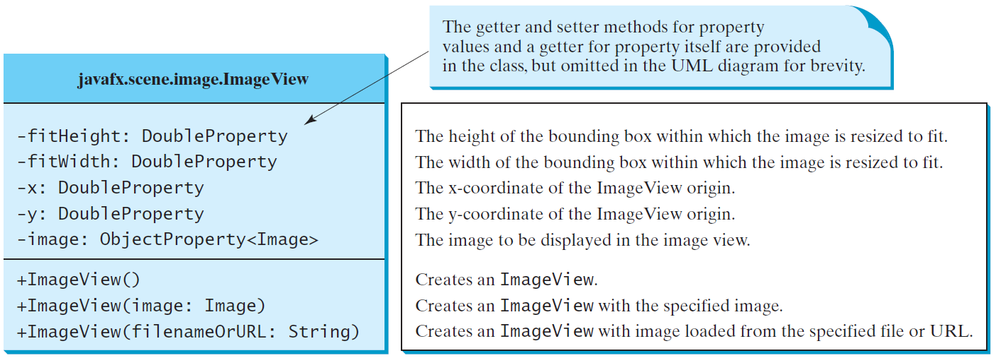
The ImageView Class
ShowImage
Run

Slide 17

import javafx.application.Application;
import javafx.scene.Scene;
import javafx.scene.layout.HBox;
import javafx.scene.layout.Pane;
import javafx.geometry.Insets;
import javafx.stage.Stage;
import javafx.scene.image.Image;
import javafx.scene.image.ImageView;
public class ShowImage extends Application {
@Override
// Override the start method in the Application class
public void start(Stage primaryStage) {
// Create a pane to hold the image views
Pane pane = new HBox(10);
pane.setPadding(new Insets(5, 5, 5, 5));
Image image = new Image("image/us.gif");
pane.getChildren().add(new ImageView(image));
ImageView imageView2 = new ImageView(image);
imageView2.setFitHeight(100);
imageView2.setFitWidth(100);
pane.getChildren().add(imageView2);
ImageView imageView3 = new ImageView(image);
imageView3.setRotate(90);
pane.getChildren().add(imageView3);
// Create a scene and place it in the stage
Scene scene = new Scene(pane);
primaryStage.setTitle("ShowImage"); // Set the stage title
primaryStage.setScene(scene); // Place the scene in the stage
primaryStage.show(); // Display the stage
}
/**
* The main method is only needed for the IDE with limited
* JavaFX support. Not needed for running from the command line.
*/
public static void main(String[] args) {
launch(args);
}
}

Slide 18
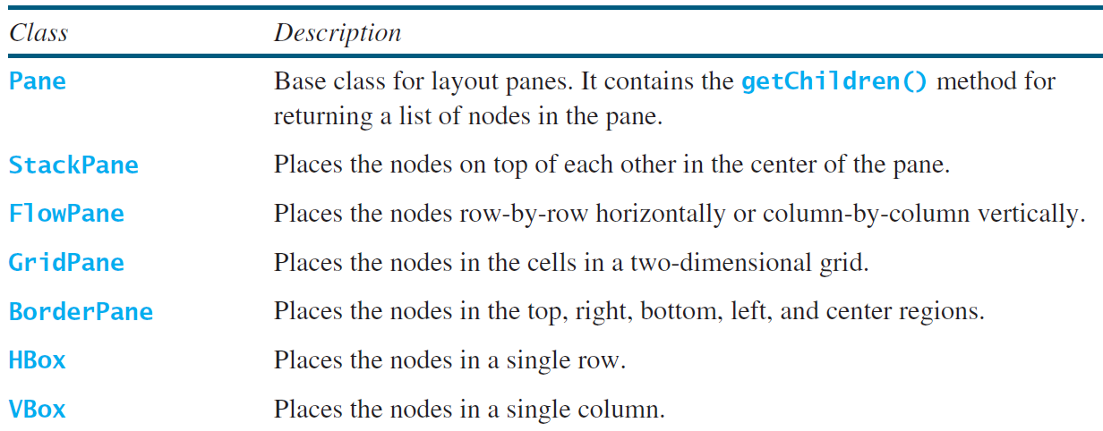
Layout Panes
JavaFX provides many types of panes for organizing nodes in a container.

Slide 19
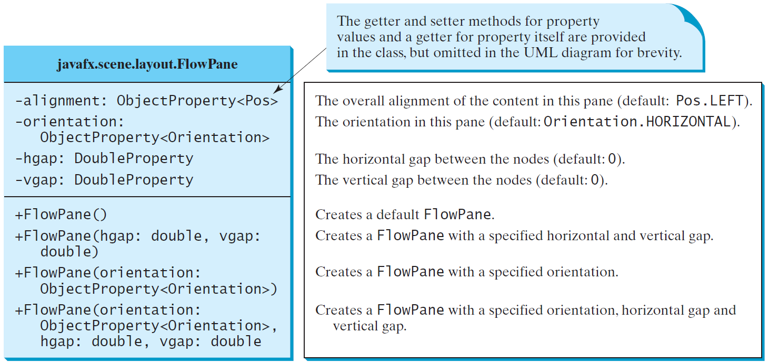
FlowPane
ShowFlowPane
Run

Slide 20
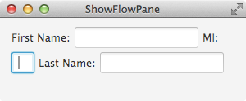
import javafx.application.Application;
import javafx.geometry.Insets;
import javafx.scene.Scene;
import javafx.scene.control.Label;
import javafx.scene.control.TextField;
import javafx.scene.layout.FlowPane;
import javafx.stage.Stage;
public class ShowFlowPane extends Application {
@Override
// Override the start method in the Application class
public void start(Stage primaryStage) {
// Create a pane and set its properties
FlowPane pane = new FlowPane();
pane.setPadding(new Insets(11, 12, 13, 14));
pane.setHgap(5);
pane.setVgap(5);
// Place nodes in the pane
pane.getChildren().addAll(new Label("First Name:"),
new TextField(), new Label("MI:"));
TextField tfMi = new TextField();
tfMi.setPrefColumnCount(1);
pane.getChildren().addAll(tfMi, new Label("Last Name:"),
new TextField());
// Create a scene and place it in the stage
Scene scene = new Scene(pane, 200, 250);
primaryStage.setTitle("ShowFlowPane"); // Set the stage title
primaryStage.setScene(scene); // Place the scene in the stage
primaryStage.show(); // Display the stage
}
/**
* The main method is only needed for the IDE with limited
* JavaFX support. Not needed for running from the command line.
*/
public static void main(String[] args) {
launch(args);
}
}

Slide 21
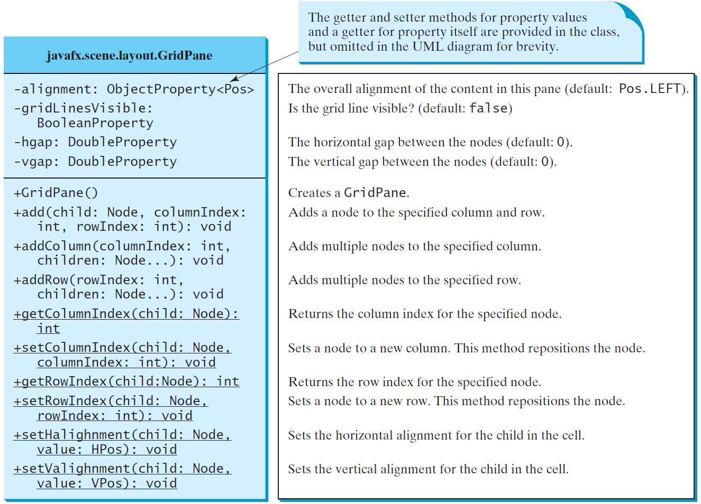
GridPane
ShowGridPane
Run

Slide 22
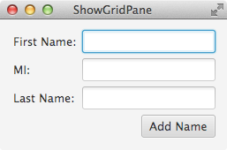
import javafx.application.Application;
import javafx.geometry.HPos;
import javafx.geometry.Insets;
import javafx.geometry.Pos;
import javafx.scene.Scene;
import javafx.scene.control.Button;
import javafx.scene.control.Label;
import javafx.scene.control.TextField;
import javafx.scene.layout.GridPane;
import javafx.stage.Stage;
public class ShowGridPane extends Application {
@Override
// Override the start method in the Application class
public void start(Stage primaryStage) {
// Create a pane and set its properties
GridPane pane = new GridPane();
pane.setAlignment(Pos.CENTER);
pane.setPadding(new Insets(11.5, 12.5, 13.5, 14.5));
pane.setHgap(5.5);
pane.setVgap(5.5);
// Place nodes in the pane
pane.add(new Label("First Name:"), 0, 0);
pane.add(new TextField(), 1, 0);
pane.add(new Label("MI:"), 0, 1);
pane.add(new TextField(), 1, 1);
pane.add(new Label("Last Name:"), 0, 2);
pane.add(new TextField(), 1, 2);
Button btAdd = new Button("Add Name");
pane.add(btAdd, 1, 3);
GridPane.setHalignment(btAdd, HPos.RIGHT);
// Create a scene and place it in the stage
Scene scene = new Scene(pane);
primaryStage.setTitle("ShowGridPane"); // Set the stage title
primaryStage.setScene(scene); // Place the scene in the stage
primaryStage.show(); // Display the stage
}
/**
* The main method is only needed for the IDE with limited
* JavaFX support. Not needed for running from the command line.
*/
public static void main(String[] args) {
launch(args);
}
}

Slide 23
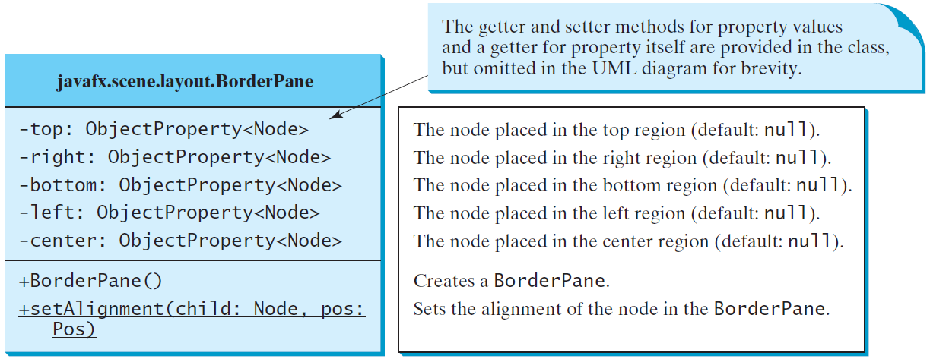
BorderPane
ShowBorderPane
Run

Slide 24
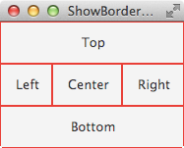
import javafx.application.Application;
import javafx.geometry.Insets;
import javafx.scene.Scene;
import javafx.scene.control.Label;
import javafx.scene.layout.BorderPane;
import javafx.scene.layout.StackPane;
import javafx.stage.Stage;
public class ShowBorderPane extends Application {
@Override // Override the start method in the Application class
public void start(Stage primaryStage) {
// Create a border pane
BorderPane pane = new BorderPane();
// Place nodes in the pane
pane.setTop(new CustomPane("Top"));
pane.setRight(new CustomPane("Right"));
pane.setBottom(new CustomPane("Bottom"));
pane.setLeft(new CustomPane("Left"));
pane.setCenter(new CustomPane("Center"));
// Create a scene and place it in the stage
Scene scene = new Scene(pane);
primaryStage.setTitle("ShowBorderPane"); // Set the stage title
primaryStage.setScene(scene); // Place the scene in the stage
primaryStage.show(); // Display the stage
}
public static void main(String[] args) {
launch(args);
}
}
// Define a custom pane to hold a label in the center of the pane
class CustomPane extends StackPane {
public CustomPane(String title) {
getChildren().add(new Label(title));
setStyle("-fx-border-color: red");
setPadding(new Insets(11.5, 12.5, 13.5, 14.5));
}
}

Slide 25
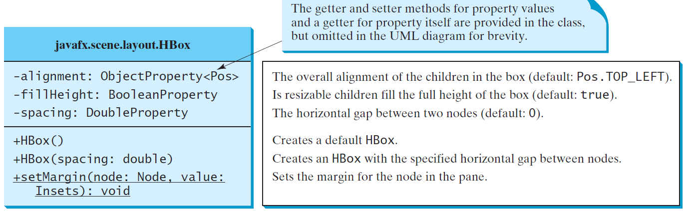
HBox

Slide 26
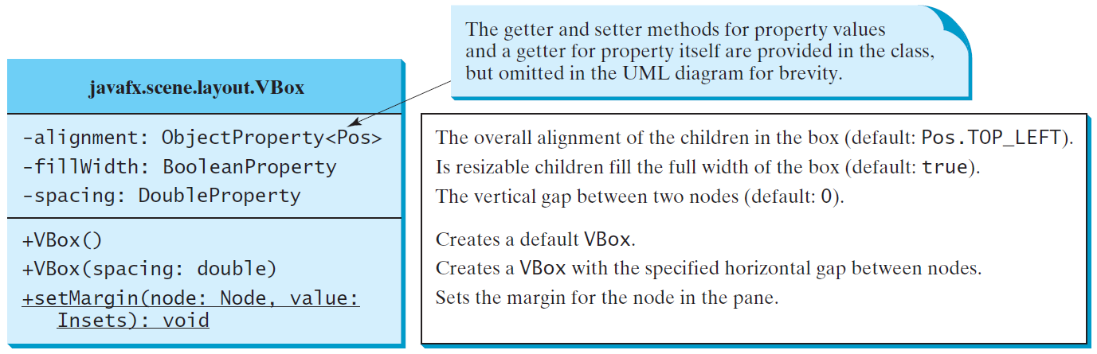
VBox
ShowHBoxVBox
Run

Slide 27
import javafx.application.Application;
import javafx.geometry.Insets;
import javafx.scene.Scene;
import javafx.scene.control.Button;
import javafx.scene.control.Label;
import javafx.scene.layout.BorderPane;
import javafx.scene.layout.HBox;
import javafx.scene.layout.VBox;
import javafx.stage.Stage;
import javafx.scene.image.Image;
import javafx.scene.image.ImageView;
public class ShowHBoxVBox extends Application {
@Override // Override the start method in the Application class
public void start(Stage primaryStage) {
// Create a border pane
BorderPane pane = new BorderPane();
// Place nodes in the pane
pane.setTop(getHBox());
pane.setLeft(getVBox());
// Create a scene and place it in the stage
Scene scene = new Scene(pane);
primaryStage.setTitle("ShowHBoxVBox"); // Set the stage title
primaryStage.setScene(scene); // Place the scene in the stage
primaryStage.show(); // Display the stage
}

Slide 28
private HBox getHBox() {
HBox hBox = new HBox(15);
hBox.setPadding(new Insets(15, 15, 15, 15));
hBox.setStyle("-fx-background-color: gold");
hBox.getChildren().add(new Button("Computer Science"));
hBox.getChildren().add(new Button("Chemistry"));
ImageView imageView = new ImageView(new Image("image/us.gif"));
hBox.getChildren().add(imageView);
return hBox;
}
private VBox getVBox() {
VBox vBox = new VBox(15);
vBox.setPadding(new Insets(15, 5, 5, 5));
vBox.getChildren().add(new Label("Courses"));
Label[] courses = {new Label("CSCI 1301"), new Label("CSCI 1302"),
new Label("CSCI 2410"), new Label("CSCI 3720")};
for (Label course: courses) {
VBox.setMargin(course, new Insets(0, 0, 0, 15));
vBox.getChildren().add(course);
}
return vBox;
}
public static void main(String[] args) {
launch(args);
}
}

Slide 29
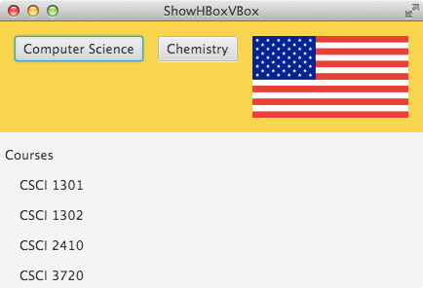

Slide 30
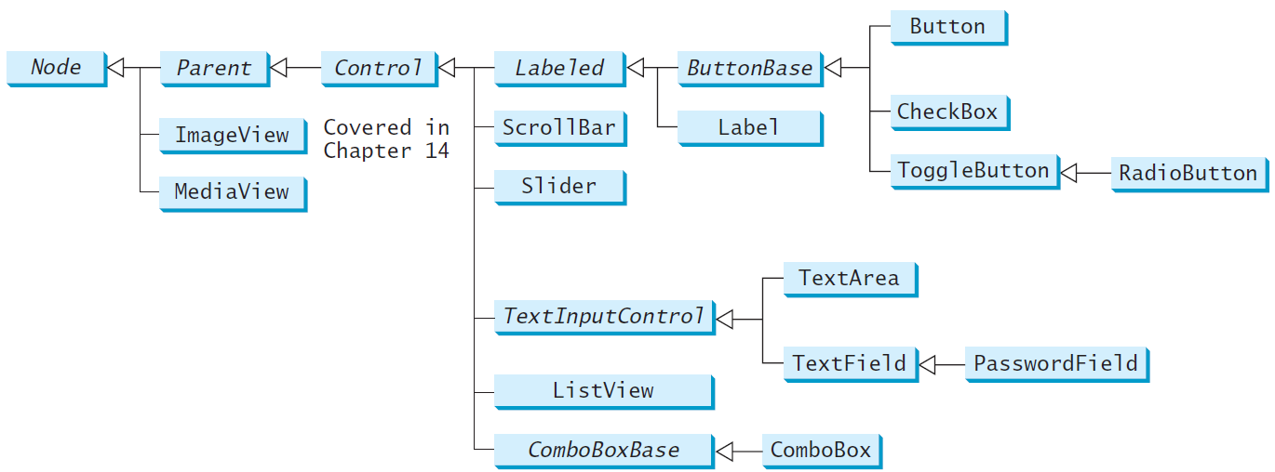
Frequently Used UI Controls
Throughout this book, the prefixes lbl, bt, chk, rb, tf, pf, ta, cbo, lv, scb, sld, and mp are used to name reference variables for Label, Button, CheckBox, RadioButton, TextField, PasswordField, TextArea, ComboBox, ListView, ScrollBar, Slider, and MediaPlayer.
Notes:
The following slides are previews. Related concepts will be covered in later chapters.

Slide 31
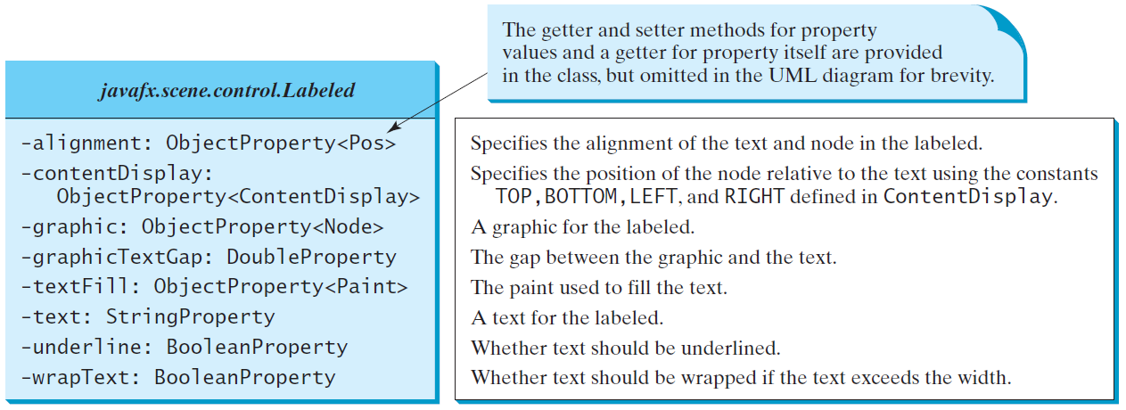
Labeled
A label is a display area for a short text, a node, or both. It is often used to label other controls (usually text fields). Labels and buttons share many common properties. These common properties are defined in the Labeled class.

Slide 32
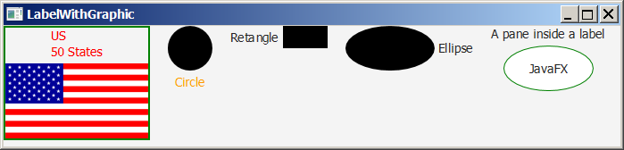
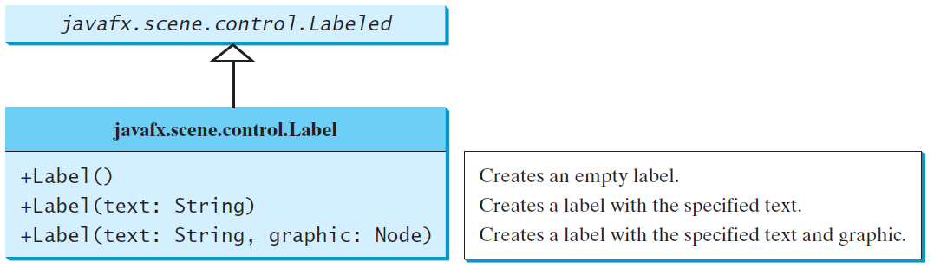
Label
The Label class defines labels.
LabelWithGraphic
Run

Slide 33
import javafx.application.Application;
import javafx.stage.Stage;
import javafx.scene.Scene;
import javafx.scene.control.ContentDisplay;
import javafx.scene.control.Label;
import javafx.scene.image.Image;
import javafx.scene.image.ImageView;
import javafx.scene.layout.HBox;
import javafx.scene.layout.StackPane;
import javafx.scene.paint.Color;
import javafx.scene.shape.Circle;
import javafx.scene.shape.Rectangle;
import javafx.scene.shape.Ellipse;
public class LabelWithGraphic extends Application {
@Override // Override the start method in the Application class
public void start(Stage primaryStage) {
ImageView us = new ImageView(new Image("image/us.gif"));
Label lb1 = new Label("US\n50 States", us);
lb1.setStyle("-fx-border-color: green; -fx-border-width: 2");
lb1.setContentDisplay(ContentDisplay.BOTTOM);
lb1.setTextFill(Color.RED);
Label lb2 = new Label("Circle", new Circle(50, 50, 25));
lb2.setContentDisplay(ContentDisplay.TOP);
lb2.setTextFill(Color.ORANGE);
Label lb3 = new Label("Retangle", new Rectangle(10, 10, 50, 25));
lb3.setContentDisplay(ContentDisplay.RIGHT);
Label lb4 = new Label("Ellipse", new Ellipse(50, 50, 50, 25));
lb4.setContentDisplay(ContentDisplay.LEFT);
Ellipse ellipse = new Ellipse(50, 50, 50, 25);
ellipse.setStroke(Color.GREEN);
ellipse.setFill(Color.WHITE);
StackPane stackPane = new StackPane();
stackPane.getChildren().addAll(ellipse, new Label("JavaFX"));
Label lb5 = new Label("A pane inside a label", stackPane);
lb5.setContentDisplay(ContentDisplay.BOTTOM);
HBox pane = new HBox(20);
pane.getChildren().addAll(lb1, lb2, lb3, lb4, lb5);
// Create a scene and place it in the stage
Scene scene = new Scene(pane, 450, 150);
primaryStage.setTitle("LabelWithGraphic"); // Set the stage title
primaryStage.setScene(scene); // Place the scene in the stage
primaryStage.show(); // Display the stage
}
/**
* The main method is only needed for the IDE with limited
* JavaFX support. Not needed for running from the command line.
*/
public static void main(String[] args) {
launch(args);
}
}

Slide 34
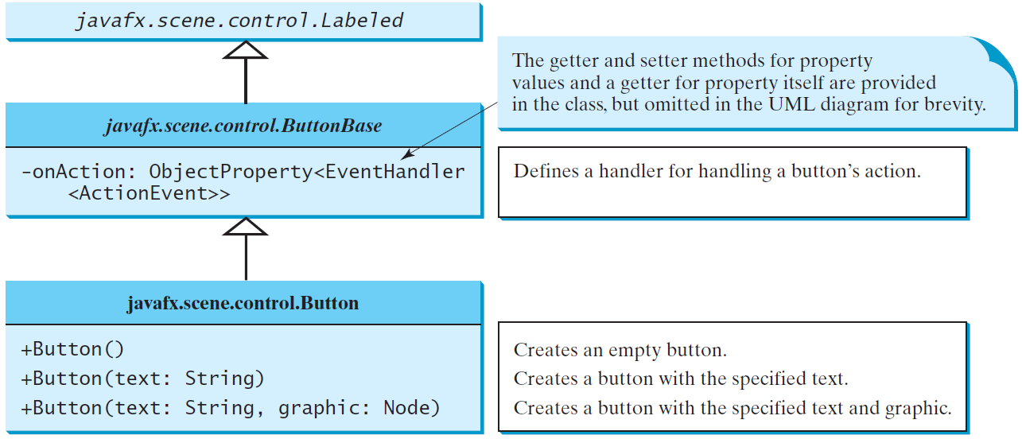
ButtonBase and Button
A button is a control that triggers an action event when clicked. JavaFX provides regular buttons, toggle buttons, check box buttons, and radio buttons. The common features of these buttons are defined in ButtonBase and Labeled classes.

Slide 35
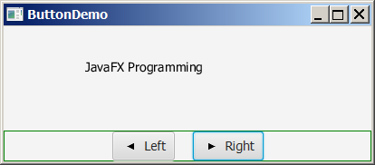
Button Example
ButtonDemo
Run

Slide 36
import javafx.application.Application;
import javafx.stage.Stage;
import javafx.geometry.Pos;
import javafx.scene.Scene;
import javafx.scene.control.Button;
import javafx.scene.image.ImageView;
import javafx.scene.layout.BorderPane;
import javafx.scene.layout.HBox;
import javafx.scene.layout.Pane;
import javafx.scene.text.Text;
public class ButtonDemo extends Application {
protected Text text = new Text(50, 50, "JavaFX Programming");
protected BorderPane getPane() {
HBox paneForButtons = new HBox(20);
Button btLeft = new Button("Left",
new ImageView("image/left.gif"));
Button btRight = new Button("Right",
new ImageView("image/right.gif"));
paneForButtons.getChildren().addAll(btLeft, btRight);
paneForButtons.setAlignment(Pos.CENTER);
paneForButtons.setStyle("-fx-border-color: green");
BorderPane pane = new BorderPane();
pane.setBottom(paneForButtons);
Pane paneForText = new Pane();
paneForText.getChildren().add(text);
pane.setCenter(paneForText);
btLeft.setOnAction(e -> text.setX(text.getX() - 10));
btRight.setOnAction(e -> text.setX(text.getX() + 10));
return pane;
}
@Override // Override the start method in the Application class
public void start(Stage primaryStage) {
// Create a scene and place it in the stage
Scene scene = new Scene(getPane(), 450, 200);
primaryStage.setTitle("ButtonDemo"); // Set the stage title
primaryStage.setScene(scene); // Place the scene in the stage
primaryStage.show(); // Display the stage
}
/**
* The main method is only needed for the IDE with limited
* JavaFX support. Not needed for running from the command line.
*/
public static void main(String[] args) {
launch(args);
}
}

Slide 37
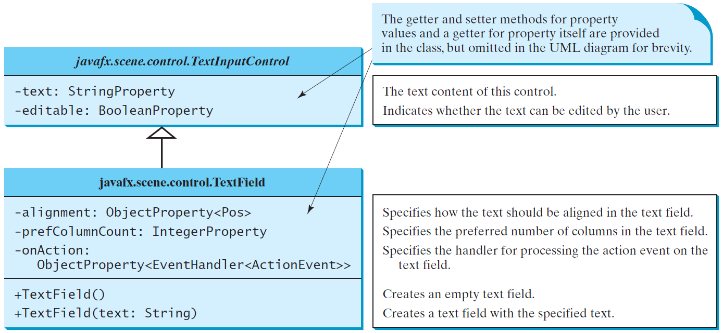
TextField
A text field can be used to enter or display a string. TextField is a subclass of TextInputControl.

Slide 38
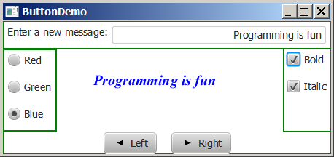
TextField Example
TextFieldDemo
Run

Slide 39
Summary
Layout panes – FlowPane, GridPane, BorderPane, Hbox, Vbox and combinations of them
  Esp. slides #20, #22, #24 and #27 – #28.
Controls – Label, Button, TextField
  Some related concepts will be covered in later chapters.

Slide 40
End of Chapter 1

